Slide 1

Struts
Introduction to Struts

Slide 2
Outline
Introduction
  What is struts?
  Why struts?
  Struts Architecture ( Struts2)
  Steps for creating web application that uses Struts2
  Struts Action
  Struts Validation Framework
  Struts HTML tags
Struts Database Access
Introduction to Struts

Slide 3
Introduction
What is Struts?
  Its an open source
  Frame work for constructing web applications
  using Servlets and JSPs
  It is the implementation of MVC (Model-View Controller) design pattern for the JSP
Introduction to Struts

Slide 4
Introduction
Why Struts? (Advantages)
  open source
  Provides components for building web applications that speed up development and saves time for developers
  Makes complex applications simple
  Built in Exception handling
  Built in validation framework
  Encourages good design practice and modeling
  Many supported 3rd-party tools
  Leverage extra features such as input validation, internationalization
Introduction to Struts

Slide 5
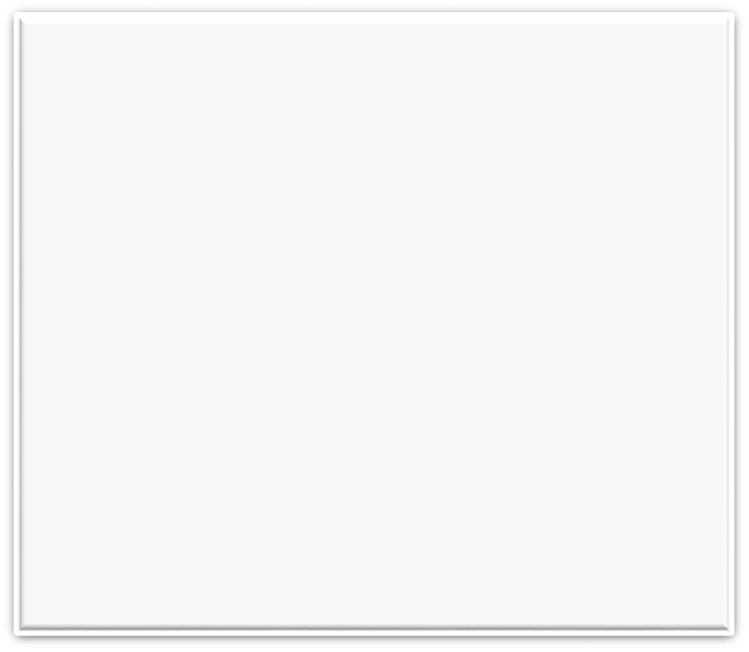
Struts Architecture
MVC Design Pattern (Traditional)
(Controller)
Servlet
1
(Client)
Browser
Request
Enterprise Servers/
Data
sources
2
instantiate
3
5
(View)
JSP
(Model)
Java Beans
Response
4
Application server
Introduction to Struts

Slide 6
The Controller Components
Web Container
Controller
Model
HTTP Request
Java Beans,
EJB
Action Servlet
Action
Client
Browser
Database
Action
Request
Preprocessor
Action
HTTP Response
View
JSP,HTML,
Custom tags, Style sheets
web.xml
Introduction to Struts
struts-config.xml
ApplicationResources.properties

Slide 7
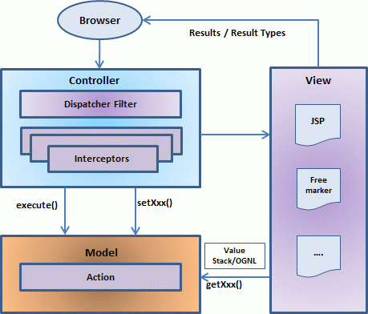
Struts Architecture
Struts2
Introduction to Struts

Slide 8
Struts Architecture
Struts2 is a pull-MVC (or MVC2) framework
Struts 2 is slightly different from a traditional MVC framework in that the action takes the role of the model rather than the controller
The controller is implemented with a Struts2 dispatch servlet filter as well as interceptors
the model is implemented with actions
the view as a combination of result types and results
Introduction to Struts

Slide 9
Struts Architecture
5 Major Components in Struts2
  1. Actions : Actions are for any MVC (Model View Controller) framework. Each URL is mapped to a specific action, which provides the processing logic necessary to service the request from the user. But the action serves in two important capacities.
    transfer of data from the request through to the view, whether its a JSP or other type of result.
    assist the framework in determining which result should render the view that will be returned in the response to the request.
Introduction to Struts

Slide 10
Struts Architecture
  2. Interceptors :conceptually the same as servlet filters or the JDKs Proxy class.
  You can achieve the following using interceptors:
    Providing preprocessing logic before the action is called.
    Providing postprocessing logic after the action is called.
    Catching exceptions so that alternate processing can be performed.
Many of the features provided in the Struts2 framework are implemented using interceptors; examples :
  include exception handling,
  file uploading, and
  validation etc.
Introduction to Struts

Slide 11
Struts Architecture
  3. Value Stack / OGNL:
  The value stack is a set of several objects which keeps the following objects in the provided order:
    Temporary Objects
    The Model Object
    The Action Object
    Named Objects
The Object-Graph Navigation Language (OGNL) is a powerful expression language that is used to reference and manipulate data on the ValueStack.
OGNL also helps in data transfer and type conversion.
The OGNL is very similar to the JSP Expression Language.
Introduction to Struts

Slide 12
Struts Architecture
  4. Results / Result types:
  The dispatcher result type is the default type, and is used if no other result type is specified. It's used to forward to a servlet, JSP, HTML page, and so on, on the server. It uses the RequestDispatcher.forward() method.
  Freemaker is a popular templating engine that is used to generate output using predefined templates
  The redirect result type calls the standard response.sendRedirect() method, causing the browser to create a new request to the given location.
Introduction to Struts

Slide 13
Struts Architecture
  5. View technologies:
  It may be the jsp pages, html pages or so on.
Introduction to Struts

Slide 14
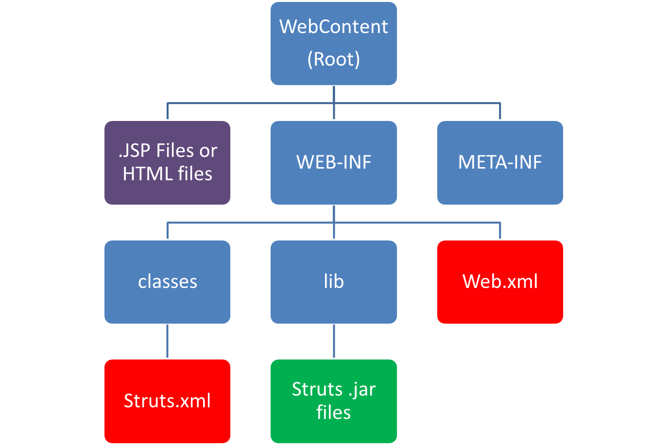
Directory Structure
Introduction to Struts

Slide 15
Steps for creating web application that uses Struts2
1) Create a dynamic web project .While creating the project select the web.xml (Deployment Descriptor).
2) Copy the .jar files in WEB-INF\lib
3) Create an Action Class (say ‘UserAction’) in the package com.mca.mit.
Introduction to Struts

Slide 16
Action Class:
package com.mca.mit;
public class UserAction
{
String firstname;
String lastname;
public String execute() throws Exception{
return "success";
}
public String getFirstname() {
return firstname;
}
public void setFirstname(String firstname) {
this.firstname = firstname;
}
public String getLastname() {
return lastname;
}
public void setLastname(String lastname) {
this.lastname = lastname;
}
Introduction to Struts

Slide 17
Steps for creating web application that uses Struts2
4) Create a View:
  a) Create First.jsp page with two input fields and Submit button
  b) Create display.jsp page and add
  <%@ taglib prefix="s" uri="/struts-tags" %>
  after page directive
Introduction to Struts

Slide 18
Steps for creating web application that uses Struts2
5) Configure the Action in the Struts Configuration File :
Uses WEB-INF/classes/struts.xml file as the Struts configuration file.
<struts>
<constant name="struts.devMode" value="true" />
<package name="helloworld" extends="struts-default">
<action name="hello"
class="com.mca.mit.UserAction"
method="execute">
<result name="success">/display.jsp</result>
</action>
</package>
</struts>
Introduction to Struts

Slide 19
Steps for creating web application that uses Struts
6) Configure web.xml file:
<display-name>Struts 2</display-name>
<welcome-file-list>
<welcome-file>first.jsp</welcome-file>
</welcome-file-list>
<filter>
<filter-name>struts2</filter-name>
<filter-class>
org.apache.struts2.dispatcher.FilterDispatcher
</filter-class>
</filter>
<filter-mapping>
<filter-name>struts2</filter-name>
<url-pattern>/*</url-pattern>
</filter-mapping>
Introduction to Struts

Slide 20
Steps for creating web application that uses Struts2
7) Run and Test Your First Struts Application
Introduction to Struts

Slide 21
Struts Action (Struts2)
  Actions are for any MVC (Model View Controller) framework. Each URL is mapped to a specific action, which provides the processing logic necessary to service the request from the user. But the action serves in two important capacities.
    transfer of data from the request through to the view, whether its a JSP or other type of result.
    assist the framework in determining which result should render the view that will be returned in the response to the request.
Introduction to Struts

Slide 22
Struts Action (Struts2)
Optionally you can extend the ActionSupport class which implements six interfaces including Action interface. The Action interface is as follows:
  public interface Action
  {
  public static final String SUCCESS = "success";
  public static final String NONE = "none";
  public static final String ERROR = "error";
  public static final String INPUT = "input";
  public static final String LOGIN = "login";
  public String execute() throws Exception;
  }
Introduction to Struts

Slide 23
Struts Action (Struts2)
package com.mit;
public class CustomerAction // Simple user Defined Action Class
{
String customername;
public String execute() throws Exception{
if(customername.equals(“MIT"))
return “success”;
else
return “error”;
}
public String getCustomername() {
return customername;
}
public void setCustomername(String customername) {
this.customername = customername;
}
}
Introduction to Struts

Slide 24
Struts Action (Struts2)
package com.mit;
import com.opensymphony.xwork2.ActionSupport;
public class CustomerAction extends ActionSupport // extending ActionSupport
{
String customername;
public String execute() throws Exception{
if(customername.equals(“MIT"))
return SUCCESS;
else
return ERROR;
}
public String getCustomername() {
return customername;
}
public void setCustomername(String customername) {
this.customername = customername;
}
}
Introduction to Struts

Slide 25
Struts Action (Struts2)
struts.xml
<struts>
<constant name="struts.devMode" value="true" />
<package name=“default" extends="struts-default">
<action name="hello"
class="com.mit.CustomerAction"
method="execute">
<result name="success">/display.jsp</result>
<result name="error">/error.jsp</result>
</action>
</package>
</struts>
}
Introduction to Struts

Slide 26
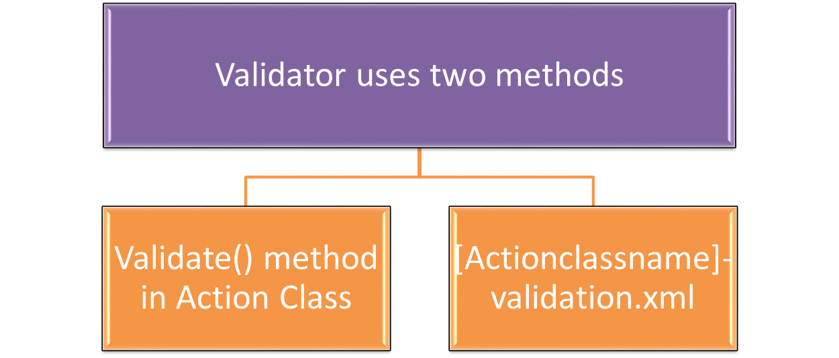
Struts Validation Framework (Struts2)
To avoid the wrong values, we need to perform validation on forms where user submits some values.
Note : add following in struts.xml’s action tag:
<result name="input">Home.jsp</result>
Introduction to Struts

Slide 27
Struts Validation Framework (Struts2)
Custom Validation : Implement the Validateable interface (or extend ActionSupport class) and provide the implementation of validate method.
Example:
import com.opensymphony.xwork2.ActionSupport;
public class RegisterAction extends ActionSupport //extending ActionSupport class
{
private String name,password;
public void validate() // overriding validate() method
{
if(name.length()<1)
addFieldError("name","Name can't be blank");
if(password.length()<6)
addFieldError("password","Password must be greater than 5");
}
}
Introduction to Struts

Slide 28
Struts Validation Framework (Struts2)
2. Built in Validators : provides many built-in validators also known as bundled validators for email, string, int, double, url, date etc .Struts 2 provides following bundled validators.
requiredstring , stringlength email , date , int , double , url ,regex
Example: [ RegisterAction-validation.xml ]
<validators>
<field name="username">
<field-validator type="requiredstring">
<param name="trim">true</param>
<message>username is required</message>
</field-validator>
</field>
<field name="age">
<field-validator type="int">
<param name="min">29</param>
<param name="max">64</param>
<message> Age must be in between 28 and 65 </message>
</field-validator>
</field>
</validators>
Introduction to Struts

Slide 29
Struts2 tags
The tags in the Struts HTML library form a bridge between a JSP view and the other components of a Web application.
Since a dynamic Web application often depends on gathering data from a user, input forms play an important role in the Struts framework.
The HTML taglib contains tags used to create Struts input forms, as well as other tags generally useful in the creation of HTML-based user interfaces.
Introduction to Struts

Slide 30
Struts2 tags
<s:form>
<s:textfield>
<s:password>
<s:label>
<s:hidden>
<s:radio> form tags
<s:checkboxlist>
<s:select>
<s:submit>
<s:file>
<s:property> data tags
<s:date>
Introduction to Struts

Slide 31
Assignment
Explain struts tags with example.
Introduction to Struts

Slide 32
Struts2 Database Access
Step1) Create a database and create a table (say “registration” table in postgresql.( or any other RDBMS)
Step2) In Eclipse :
(1) Copy all the struts .jar and postgresql .jar files in WEB-INF\lib folder.
(2) Design registration.jsp page using struts tags
Introduction to Struts

Slide 33
Struts2 Database Access
Resgistration.jsp
<%@ page language="java" contentType="text/html; charset=ISO-8859-1"
pageEncoding="ISO-8859-1"%>
<%@taglib prefix="s" uri="/struts-tags" %>
<html>
<body>
<h2> REGISTRATION FORM</h2>
<s:form action="firstaction">
<s:textfield name="username" label="Choose Username"/>
<s:password name="choosepwd" label="Choose Password"/>
<s:password name="confirmpwd" label="Confirm Password"/>
<s:radio name="gender" label="Gender" list="{'Male','Female'}"/>
<s:select name="city" label="Select City" list="{'Aurangabad','Pune','Nashik'}"/>
<s:submit value="Submit"/>
</s:form>
</body>
</html>
Introduction to Struts

Slide 34
Struts2 Database Access
Web.xml (WEB-INF)
<welcome-file-list>
<welcome-file>Registration.jsp</welcome-file>
</welcome-file-list>
Struts.xml ( WEB-INF\classes\struts.xml)
<package name="default" extends="struts-default">
<action name="firstaction" class="com.mca.RegistrationAction" method="execute">
<result name="success">/success.jsp</result>
<result name="error">/error.jsp</result>
</action>
</package>
(3) Configure the web.xml and struts.xml files
Introduction to Struts

Slide 35
Struts2 Database Access
(4) Create an Action class with getter/setters and execute method. The execute() method will include the JDBC code.
package com.mca;
import com.opensymphony.xwork2.ActionSupport;
import java.sql.*;
public class RegistrationAction extends ActionSupport {
String username,choosepwd,gender,city;
//getters and setters
public String getUsername() {return username;}
public void setUsername(String username) { this.username = username;}
public String getChoosepwd() {return choosepwd;}
public void setChoosepwd(String choosepwd) {this.choosepwd = choosepwd;}
public String getGender() {return gender;}
public void setGender(String gender) {this.gender = gender;}
public String getCity() {return city;}
public void setCity(String city) {this.city = city;}
Introduction to Struts

Slide 36
Struts2 Database Access
public String execute() //execute method with JDBC code
{
Connection con=null;PreparedStatement pst;
String ret=ERROR;String connURL="jdbc:postgresql://localhost:5433/postgres";
try{
Class.forName("org.postgresql.Driver");
con=DriverManager.getConnection(connURL,"postgres","root");
pst=con.prepareStatement("insert into registration values(?,?,?,?)");
pst.setString(1, username);pst.setString(2, choosepwd);pst.setString(3, gender);
pst.setString(4, city);
int x=pst.executeUpdate();
ret=SUCCESS;
}catch(Exception ex){
ret=ERROR;
}
return ret;
}
}
Introduction to Struts

Slide 37
Struts2 Database Access
success.jsp
<%@ page language="java" contentType="text/html; charset=ISO-8859-1"
pageEncoding="ISO-8859-1"%>
<html>
<body>
INSERTED SUCCESSFULLY...
</body>
</html>
error.jsp
<%@ page language="java" contentType="text/html; charset=ISO-8859-1"
pageEncoding="ISO-8859-1"%>
<html>
<body>
ERROR IN PAGE..
</body>
</html>
(5) Create success.jsp and error.jsp
Introduction to Struts

Slide 38
Struts2 Database Access
(6) Run and Test Your Struts database Application
Introduction to Struts

